Slide 1
Netflix Analysis
Project 3

Slide 2
Contents
Background
Ethical concerns
Approach
Limitations
Netflix Market Review
Netflix data analysis
Recommendations and conclusion

Slide 3
Background
As Data analysts we are supposed to tell a story based on in-depth data analysis on real-life generated data. This time, we want to tell a story about Netflix users.
Our goal was to analyze Netflix’s revenue and profits using multiple data visualization techniques to tell a compelling story about the Netflix user base. We also tried to understand the ethical traditions while data gathering.

Slide 4

Ethical concern

Slide 5
Ethical considerations
Data gathering
(collecting data without honest consent, multiple user data)
Data ownership
(what gives a company a right to claim data, do real people know what’s happening to their data?)
Notes:
Data gathering (collecting data without honest consent, multiple user data)
Data ownership (what gives a company a right to claim data, do real people know what’s happening to their data?)

Slide 6
Ethical Solution
Data anonymization
(modifying personal data in such a way that the individuals to whom the data pertains cannot be readily identified)
Ever-evolving regulations (Federal Privacy laws)

Slide 7
Approach
We used data available to us
Understand the data we had
Plan our analyses (we made sure to use everything in the 2.5 months
Data modeling and interpretation.

Slide 8
Limitations
Not enough data to distinguish age and gender based on questions (viewing hours, peak viewing time)
Not enough data to fully understand the number of users in each country (how many users, population proportions)
Not enough data to understand the trends of data distribution

Slide 9

Netflix market review

Slide 10
Revenue and projection
Netflix has seen an increase in revenue from year to year in the last five years. Comparing 2022 to 2023, the revenue has increased by 42.86%. This year, it already has increased by 16.36% for the first quarter.
With this trajectory, Netflix revenue is very likely to increase.
With more than 270 million subscribers, the subscription number is trending up this continues to engage a vast and diverse user base, signifying its widespread appeal and market penetration.

Slide 11
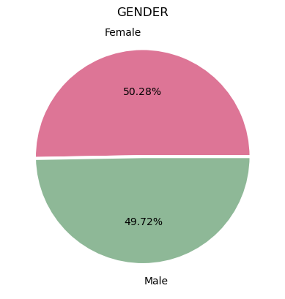
GENDER DISTRIBUTION
Gender Comparison – The gender distribution between male and female is slightly different by 0.28% based on our data.
Both gender almost equally enjoy using Netflix

Slide 12
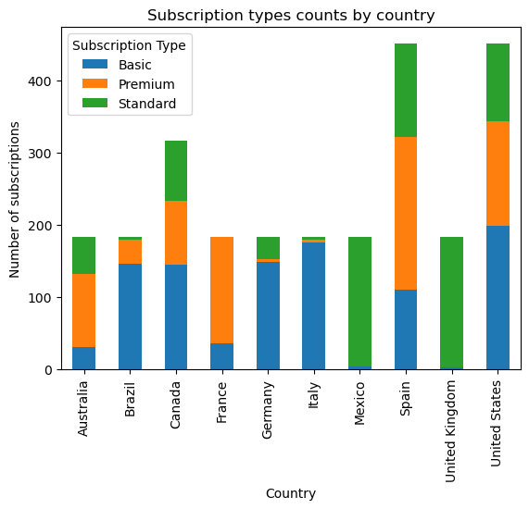
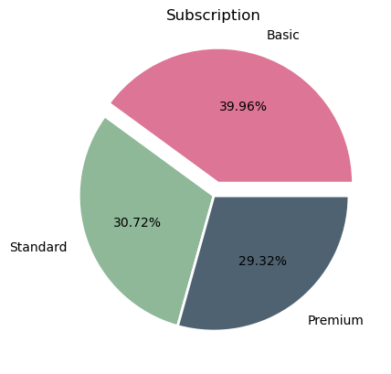
SUBSCRIPTION
Most users of 39.96% subscribed to the basic subscription
Most users who subscribed to basic option were from the United States
Users from the UK and Mexico used only standard subscription – Not clear if they had other options from the data
The standard subscription has the next highest users of 30.72%
Premium subscribers has the least users in Germany, Italy, Brazil and Australia
French and Spanish users subscribe to premium subscriptions

Slide 13
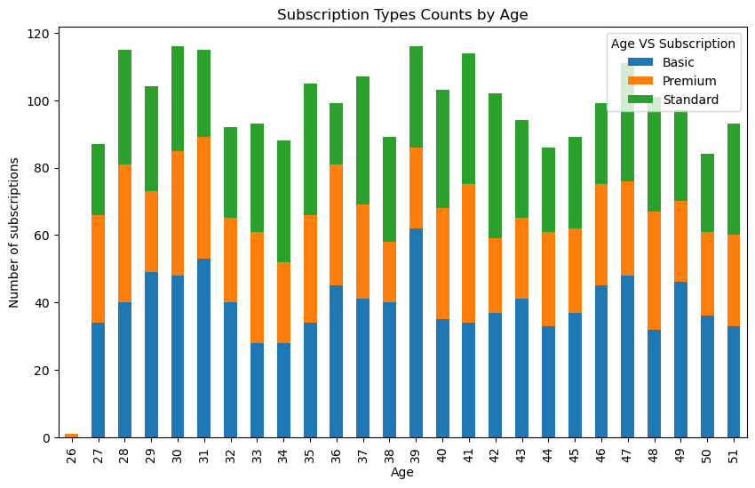
AGE AND SUBSCRIPTION
Correlation between user age and subscription is consistent across all subscription types.
There are more basic users across subscription types , especially, 39 years olds
Except for 26 years olds, who barely have subscription. However, the those who have at all have the premium subscription

Slide 14
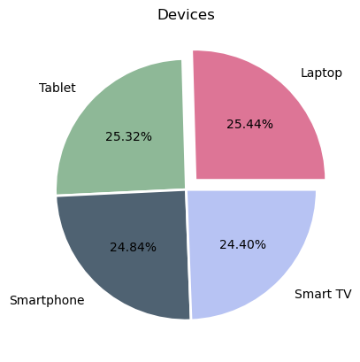
DEVICE USAGE
Devices used by Netflix subscribers does not significantly differ from one another
All four devices are significantly used

Slide 15
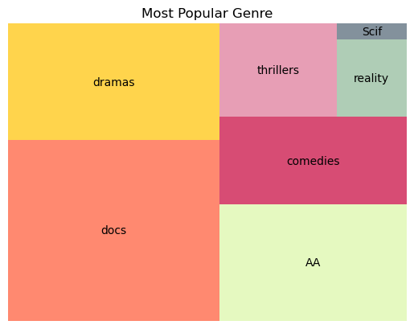
GENRE
Most popular genre is documentaries, according to the data
Action contents are the next popular, followed by drama, then comedies
The least popular content is sci-fi among subscribers

Slide 16
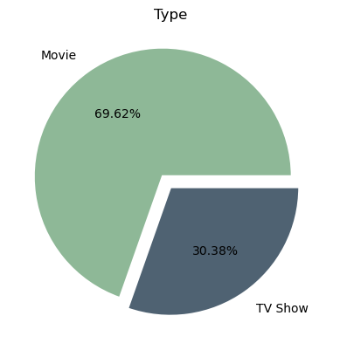
CONTENT TYPES
Most subscribers watch movies than TV shows
69.62%prefer movies while only 30.38% prefer TV shows.
There is no significant data to show the reason users prefer movies to TV shows

Slide 17
RECOMMENDATIONS
There should be considerable investment in Movies as most subscribers watch more movies than TV shows
Documentaries are widely watched by users. Thus, the company can invest in more documentaries , with the sci-fi being the least to be invested in
Netflix may also invest more in action and drama
The company needs to market premium subscription advantages to users in the UK, Mexico, Italy, Brazil, Germany and Australia

Slide 18
Privacy and consent.
Render data anonymous.
Research on technology to change the data-acquiring rules.
Notes:
By prioritizing privacy and consent, ensuring fairness and accountability, and considering the broader societal impacts of their work, data scientists can harness the power of data responsibly and ethically. The goal should be to create data-driven solutions that not only advance technology but also promote social good and uphold fundamental ethical principles.

Slide 19
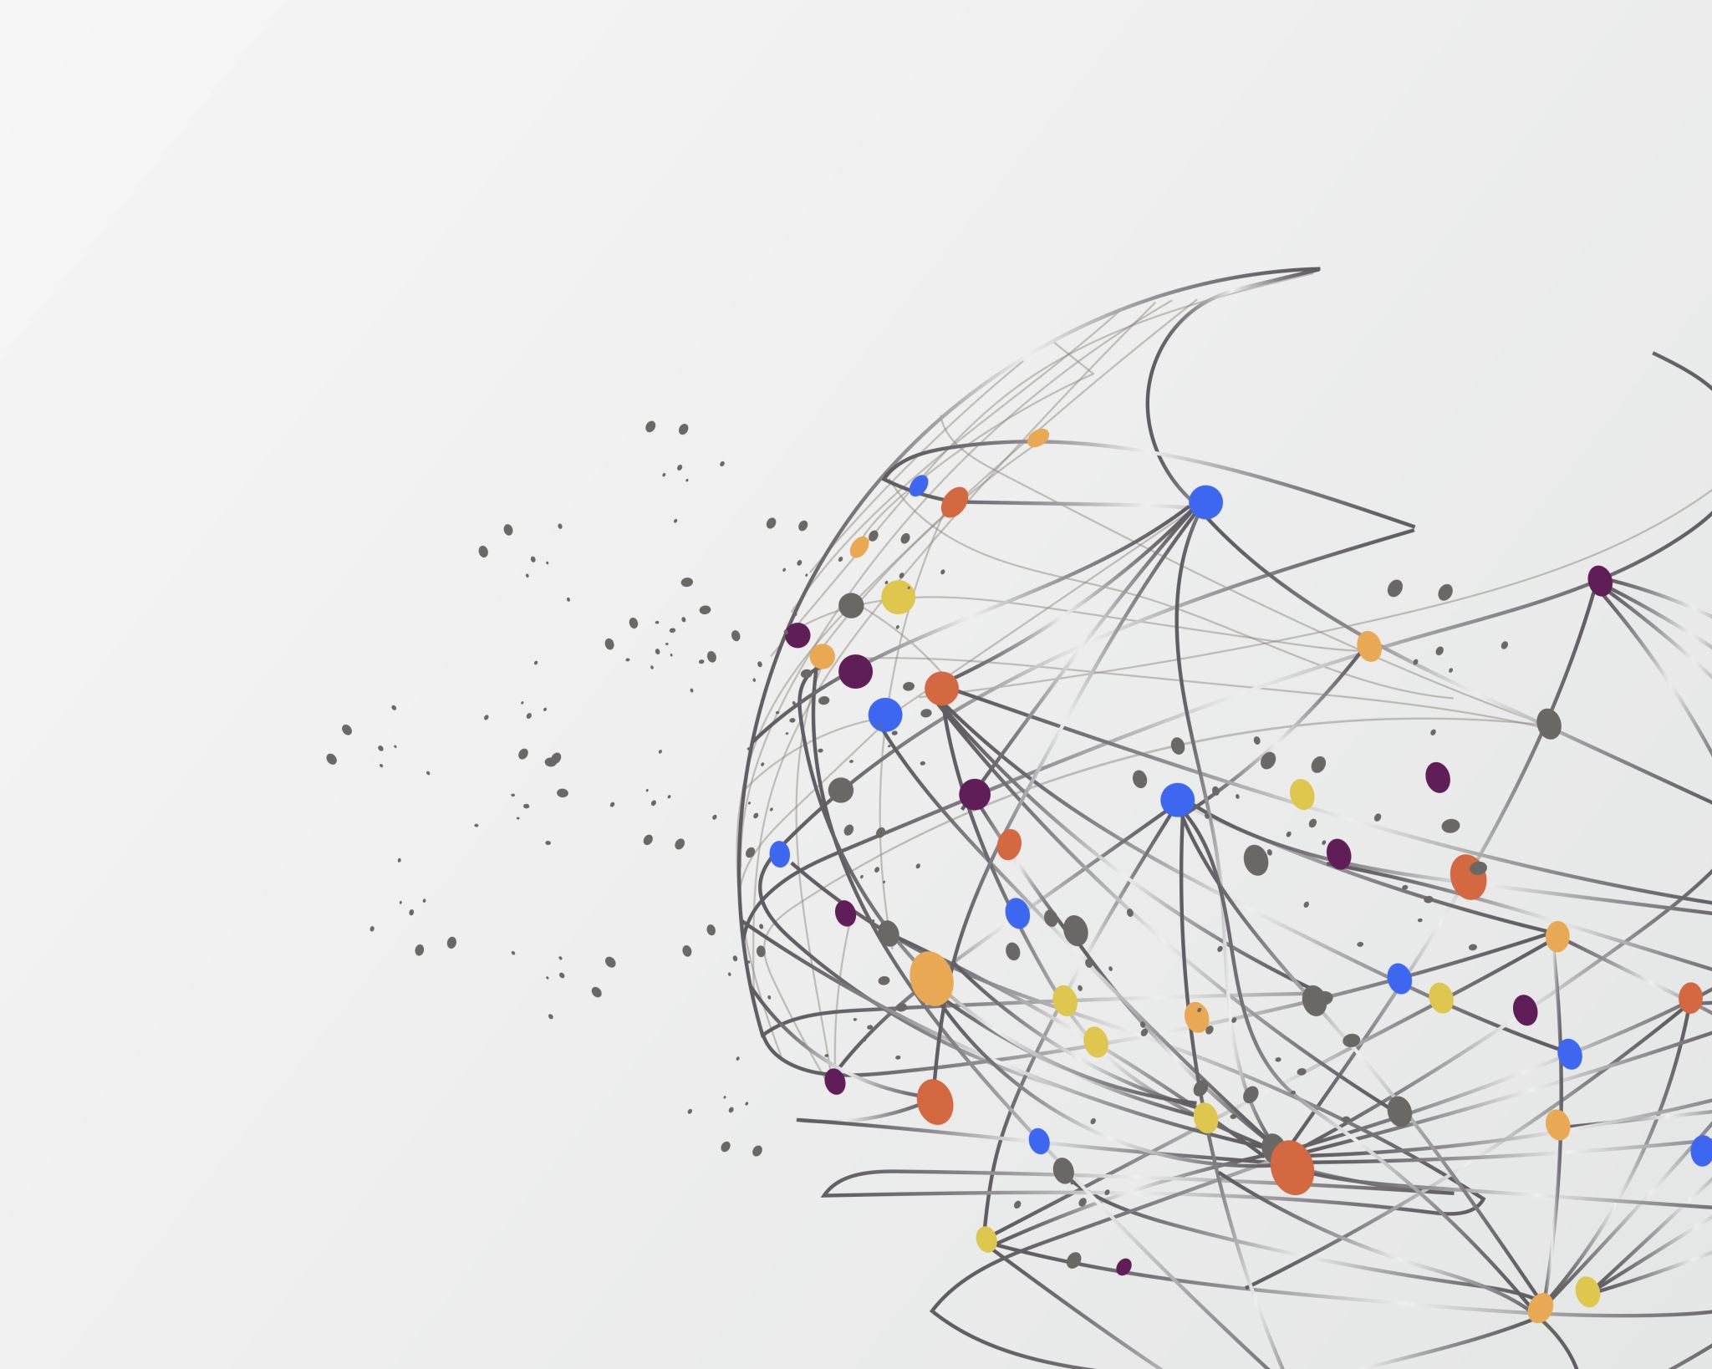
Thank you
Abigail Diche, Alexa Lutz, Brittany Hammond, Lexi Schroeder, Soumik Sarkar , Vlad koledin, Charly Ilunga

